Slide 1
Xamarin Community Toolkit

Slide 3

Xamarin Community Toolkit
The Xamarin Community Toolkit is a collection of common elements for mobile development with Xamarin.Forms that people tend to replicate across multiple apps. It simplifies and demonstrates common developer tasks when building apps with Xamarin.Forms.
The library contains:
Behaviors
Converters
Effects
Views

Slide 4
Behaviors

Slide 5
DEMO: Let's take a look at the behaviors

Slide 6
Converters

Slide 7
Converters
Suppose you want to define a data binding where the source property is of type int but the target property is a bool. You want this data binding to produce a false value when the integer source is equal to 0, and true otherwise.
You can do this with a class that implements the IValueConverter creating something you probably know, Converters.
In the XCT, we try to group those common Converters, which are repeated from app to app to simplify the process.
ByteArrayToImageSourceConverter
DateTimeOffsetConverter
ItemSelectedEventArgsConverter
ItemTappedEventArgsConverter
MultiConverter

Slide 8
DEMO: Let's take a look at the converters

Slide 9
Effects

Slide 10
Effects
Effects allow the native controls on each platform to be customized, and are typically used for small styling changes.
Available Effects:
IconTintColorEffect
RemoveBorderEffect
SafeAreaEffect
SelectAllTextEffect

Slide 11
DEMO: Let's take a look at the effects

Slide 12
Views

Slide 13
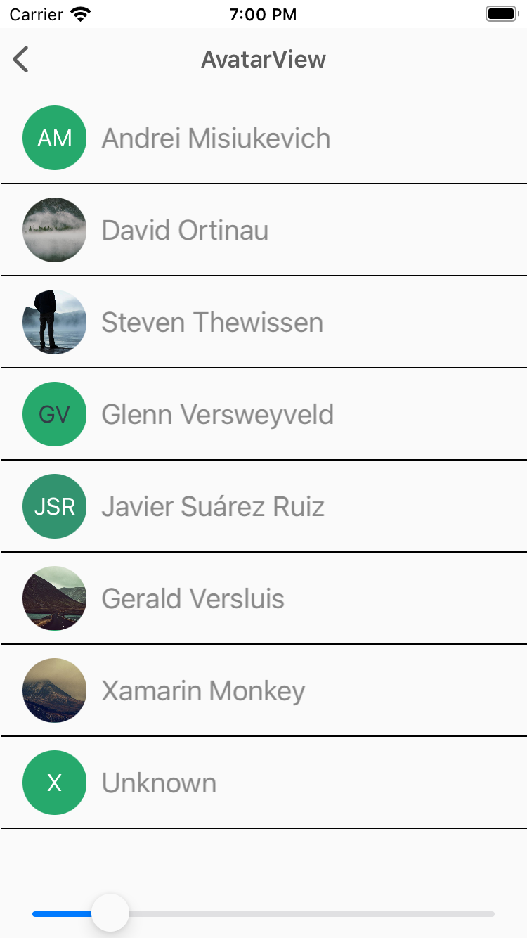
AvatarView
The AvatarView represents a user's name by using the initials and a generated background color.
<xct:AvatarView
ColorTheme="{x:Static xct:ColorTheme.Jungle}"
FontSize="Medium”>
<xct:AvatarView.Source>
<UriImageSource Uri="{Binding Source}" />
</xct:AvatarView.Source>
</xct:AvatarView>

Slide 14
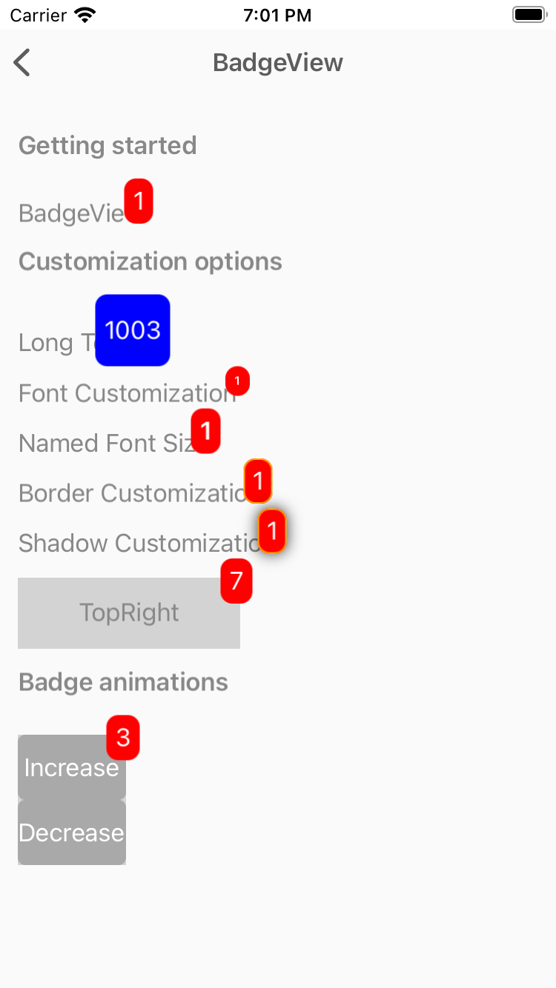
BadgeView
View used to used to notify users notifications, or status of something.
<xct:BadgeView
BackgroundColor="Red"
TextColor="White"
Text="1">
<Label
Text="BadgeView"/>
</xct:BadgeView>

Slide 15
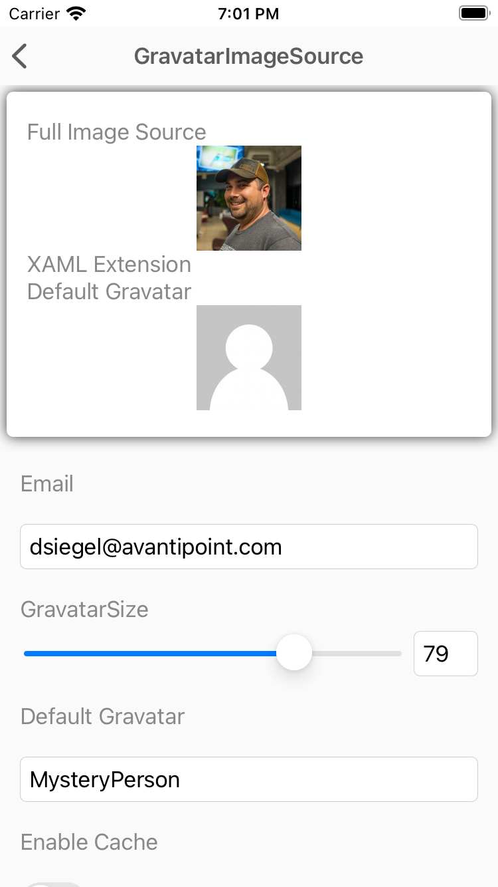
GravatarImageSource
The GravatarImageSource allows you to easily utilize a users Gravatar image from Gravatar.com using nothing but their email address.
<Image>
<Image.Source>
<xct:GravatarImageSource
Email="{Binding Email}"
Size="{Binding Size}"
CachingEnabled="{Binding EnableCache}" />
</Image.Source>
</Image>

Slide 16
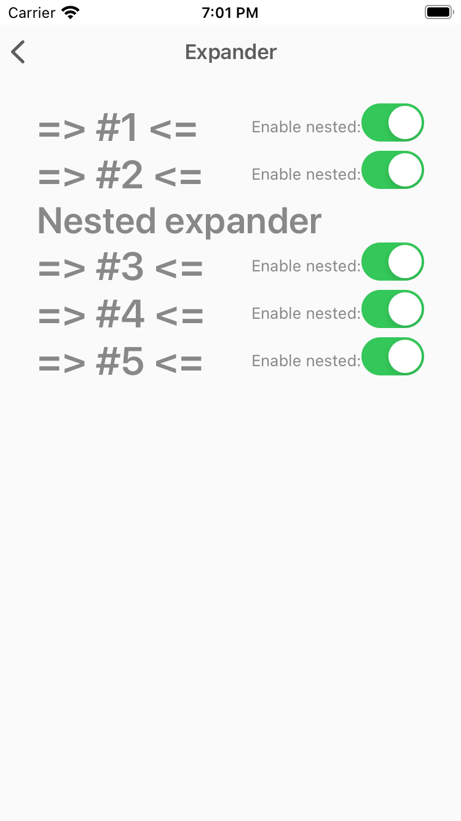
Expander
The Expander control provides an expandable container to host any content.
<xct:Expander IsEnabled="{Binding IsEnabled}">
<xct:Expander.Header>
<Label Text="Nested expander" FontSize="30" FontAttributes="Bold"/>
</xct:Expander.Header>
<xct:Expander.ContentTemplate>
<DataTemplate>
<StackLayout Spacing="0" Margin="10" Padding="1" BackgroundColor="Black">
<BoxView HeightRequest="50" Color="White" />
<BoxView HeightRequest="50" Color="Red" />
<BoxView HeightRequest="50" Color="White" />
</StackLayout>
</DataTemplate>
</xct:Expander.ContentTemplate>
</xct:Expander>

Slide 17
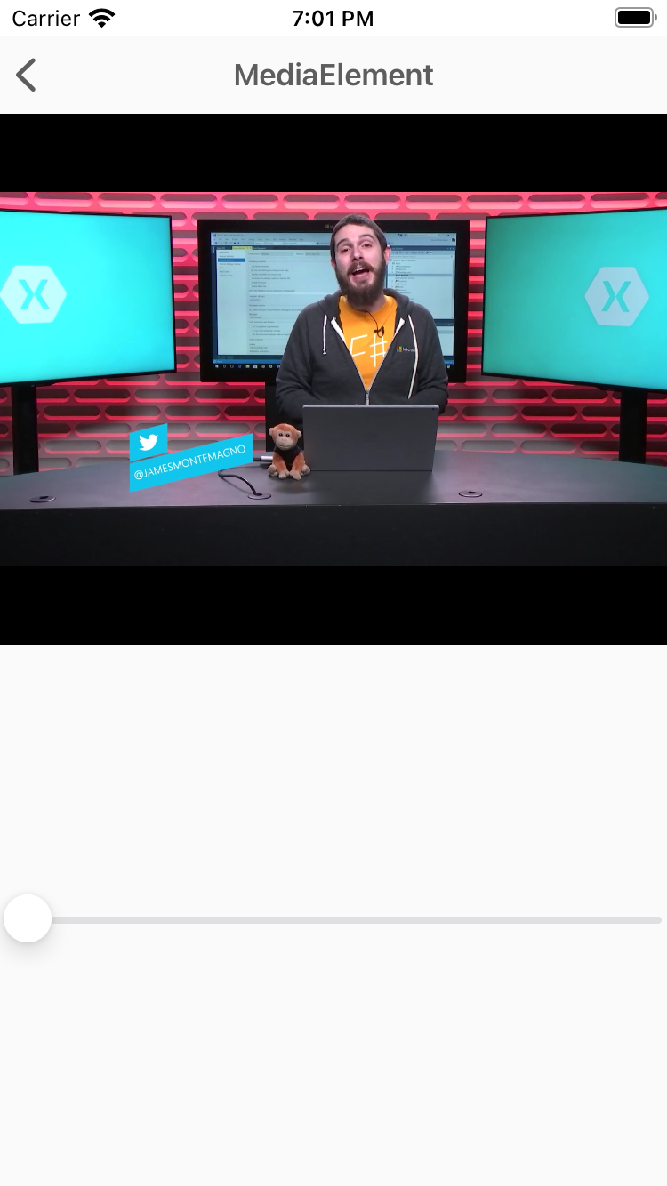
MediaElement
MediaElement is a view for playing video and audio.
<xct:MediaElement
x:Name="mediaElement"
Source="https://sec.ch9.ms/ch9/5d93/a1eab4bf-3288-4faf-81c4-294402a85d93/XamarinShow_mid.mp4"
ShowsPlaybackControls="True"
MediaOpened="OnMediaOpened"
MediaFailed="OnMediaFailed"
MediaEnded="OnMediaEnded"
SeekCompleted="OnSeekCompleted" />

Slide 18
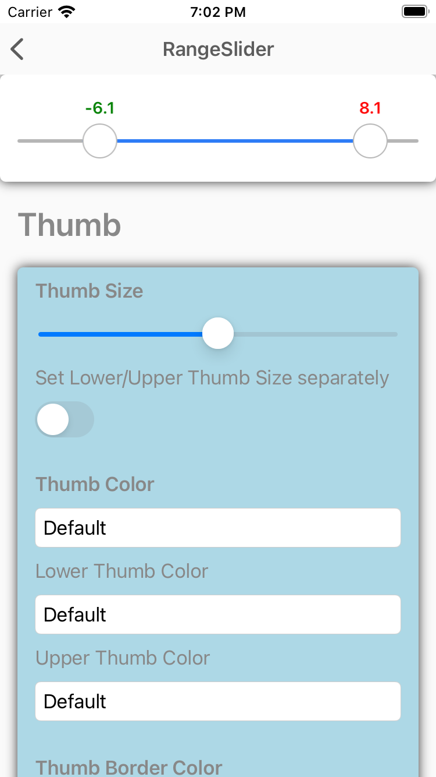
RangeSlider
The RangeSlider is a slider with two thumbs allowing to select numeric ranges.
<xct:RangeSlider
x:Name="RangeSlider"
MaximumValue="10"
MinimumValue="-10"
StepValue="0.01"
LowerValue="-10"
UpperValue="10”>
<xct:RangeSlider.LowerThumbView>
<Label Text="L" VerticalTextAlignment="Center" HorizontalTextAlignment="Center" IsVisible="{Binding IsToggled, Source={x:Reference LowerThumbViewSwitch}}" />
</xct:RangeSlider.LowerThumbView>
<xct:RangeSlider.UpperThumbView>
<Label Text="U" VerticalTextAlignment="Center" HorizontalTextAlignment="Center" IsVisible="{Binding IsToggled, Source={x:Reference UpperThumbViewSwitch}}" />
</xct:RangeSlider.UpperThumbView>
</xct:RangeSlider>

Slide 19
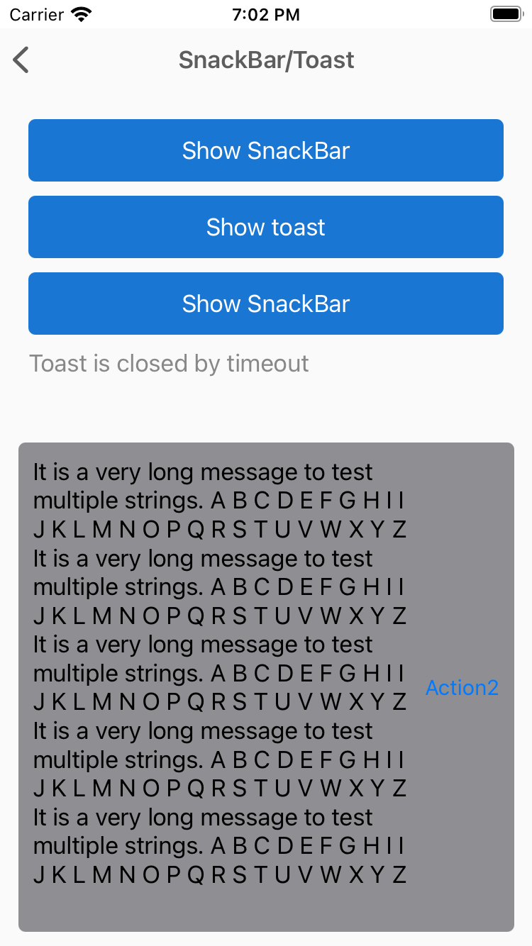
SnackBar
Show SnackBar, Toast etc.
var messageOptions = new MessageOptions
{
Message = GenerateLongText(5)
};
var actionOptions = new List<SnackBarActionOptions>
{
new SnackBarActionOptions
{
Text = "Action1",
Action = () =>
{
Debug.WriteLine("1");
return Task.CompletedTask;
}
},
new SnackBarActionOptions
{
Text = "Action2",
Action = () =>
{
Debug.WriteLine("2");
return Task.CompletedTask;
}
}
};
var options = new SnackBarOptions
{
MessageOptions = messageOptions,
Duration = TimeSpan.FromMilliseconds(5000),
Actions = actionOptions
};
var result = await this.DisplaySnackBarAsync(options);

Slide 20
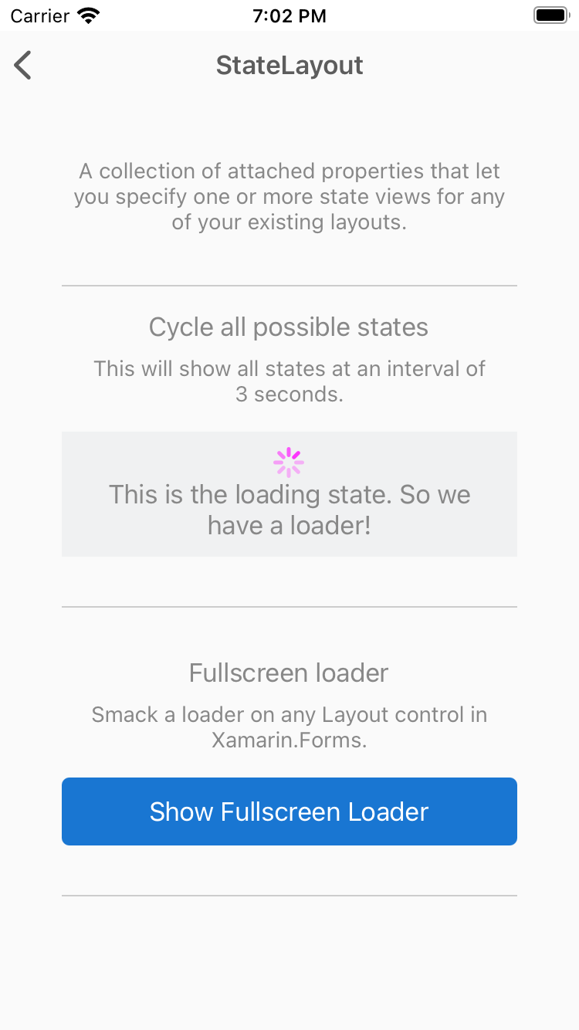
StateLayout
A collection of attached properties that let you specify one or more state views for any of your existing layouts.
<xct:StateLayout.StateViews>
<xct:StateView StateKey="Loading" BackgroundColor="White" VerticalOptions="FillAndExpand">
<StackLayout VerticalOptions="Center" HorizontalOptions="Center">
<ActivityIndicator Color="#1abc9c" IsRunning="{Binding MainState, Converter={StaticResource StateToBooleanConverter}, ConverterParameter={x:Static xct:LayoutState.Loading}}" />
<Label Text="Loading..." HorizontalOptions="Center" />
</StackLayout>
</xct:StateView>
</xct:StateLayout.StateViews>

Slide 21
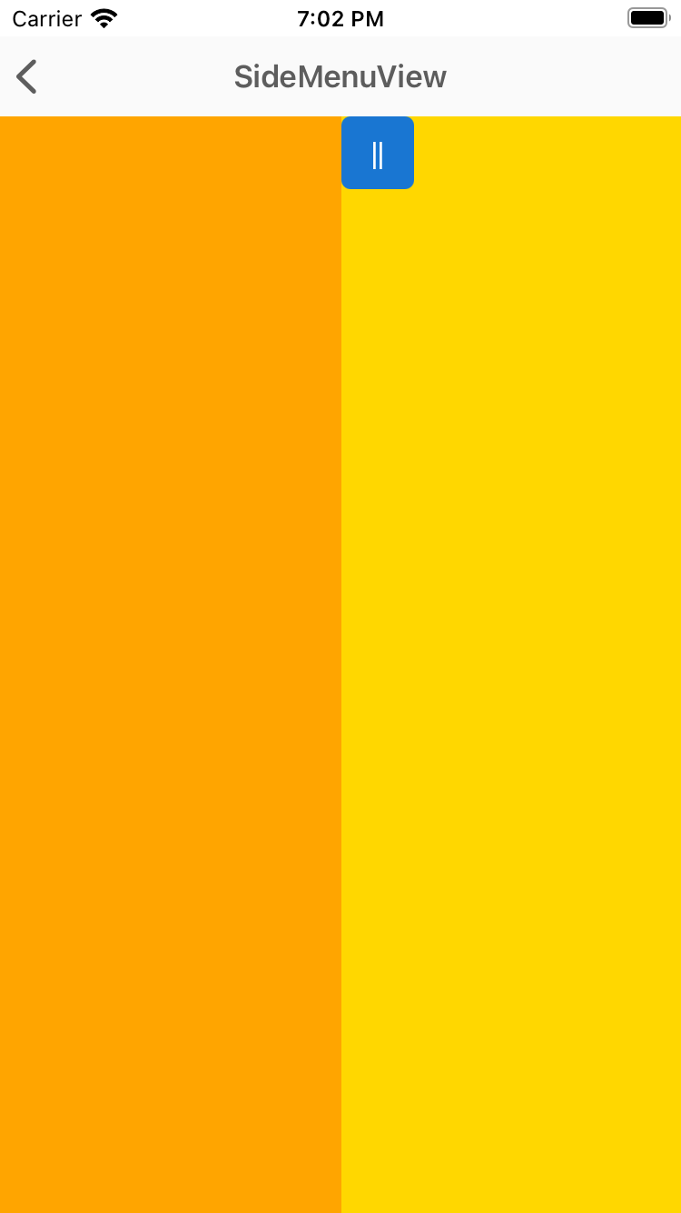
SideMenuView
SideMenuView is a simple and flexible Right/Left menu control.
<xct:SideMenuView x:Name="SideMenuView">
<!-- MainView -->
<StackLayout
Orientation="Horizontal"
BackgroundColor="Gold">
<Button Style="{StaticResource BaseMenuButtonStyle}"
Clicked="OnLeftButtonClicked" />
<Button Style="{StaticResource BaseMenuButtonStyle}"
HorizontalOptions="EndAndExpand"
Clicked="OnRightButtonClicked" />
</StackLayout>
<!-- LeftMenu -->
<BoxView
BackgroundColor="Orange"
xct:SideMenuView.Position="LeftMenu"
xct:SideMenuView.MenuWidthPercentage=".5" />
<!-- RightMenu -->
<BoxView
BackgroundColor="LightGreen"
xct:SideMenuView.Position="RightMenu"
xct:SideMenuView.MenuWidthPercentage=".3" />
</xct:SideMenuView>

Slide 22
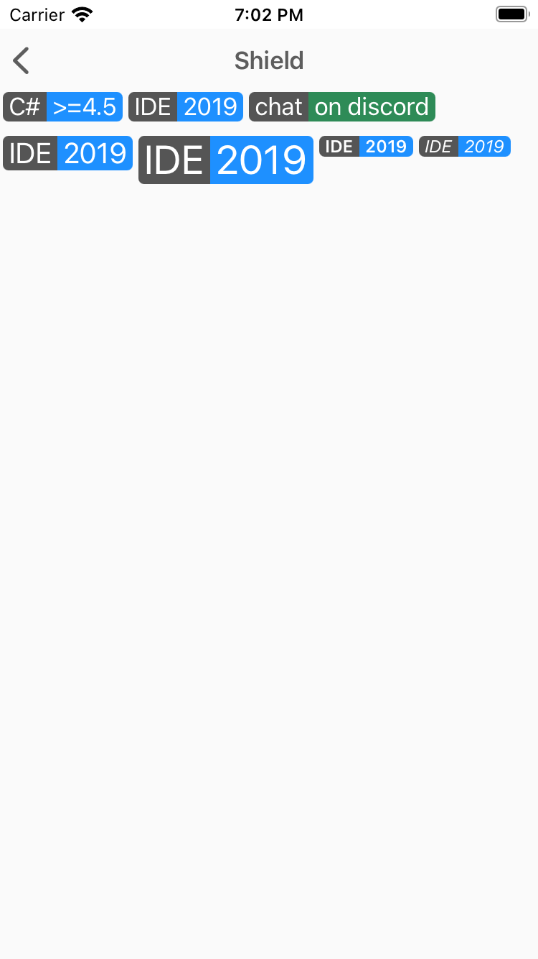
Shield
Shields can show some status information or call-to-action in a badge-like way.
<xct:Shield
Subject="IDE"
Status="2019"
Color="DodgerBlue"
TextColor="White"
Margin="2,0" />

Slide 23
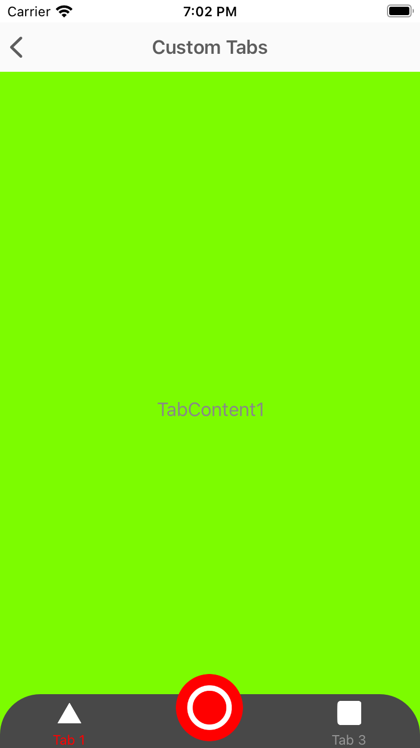
TabView
Shields can show some status information or call-to-action in a badge-like way.
<xct:TabView
TabStripPlacement="Bottom"
TabStripBackgroundColor="Blue"
TabStripHeight="60"
TabIndicatorColor="Yellow"
TabContentBackgroundColor="Yellow">
<xct:TabViewItem
Icon="triangle.png"
Text="Tab 1"
TextColor="White"
TextColorSelected="Yellow"
FontSize="12">
<Grid
BackgroundColor="Gray">
<Label
HorizontalOptions="Center"
VerticalOptions="Center"
Text="TabContent1" />
</Grid>
</xct:TabViewItem>
<xct:TabViewItem
Icon="circle.png"
Text="Tab 2"
TextColor="White"
TextColorSelected="Yellow"
FontSize="12">
<Grid>
<Label
HorizontalOptions="Center"
VerticalOptions="Center"
Text="TabContent2" />
</Grid>
</xct:TabViewItem>
</xct:TabView>

Slide 24
DEMO: Let's take a look at the controls

Slide 25
Questions?

Slide 26


